Slide 1
University of Architecture, Civil Engineering and Geodesy
Assoc. Prof. Dr. Eng. Petar Filkov
University of Architecture, Civil Engineering and Geodesy, Sofia, Bulgaria
Kick-off Meeting in University in Nis/ 20-21.12.2018
This project has been funded with support from the European Commission. This publication reflects the views only of the author, and the Commission cannot be held responsible for any use which may be made of the information contained therein.

Slide 2

Educating and Building Bulgaria 75 years
Strengthening of master curricula in water resources management
for the Western Balkans HEIs and stakeholders
www.swarm.ni.ac.rs

Slide 3

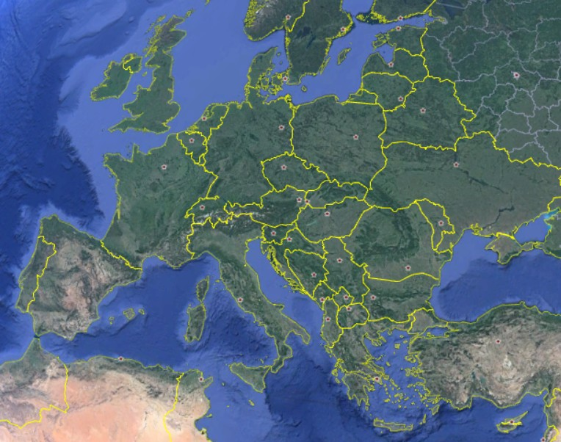
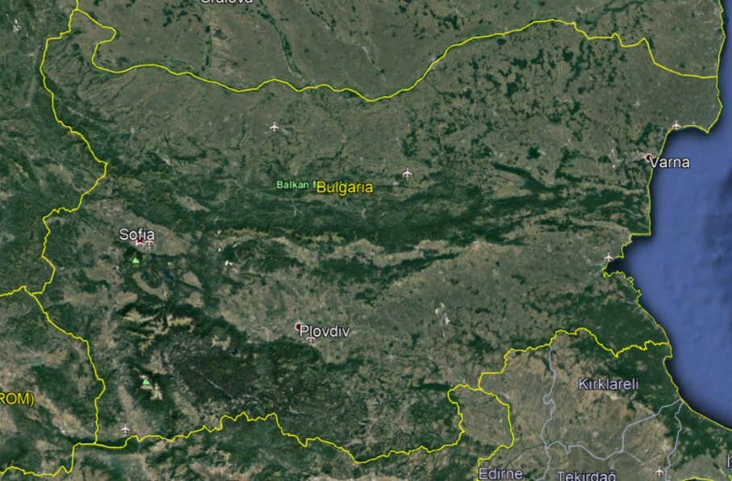
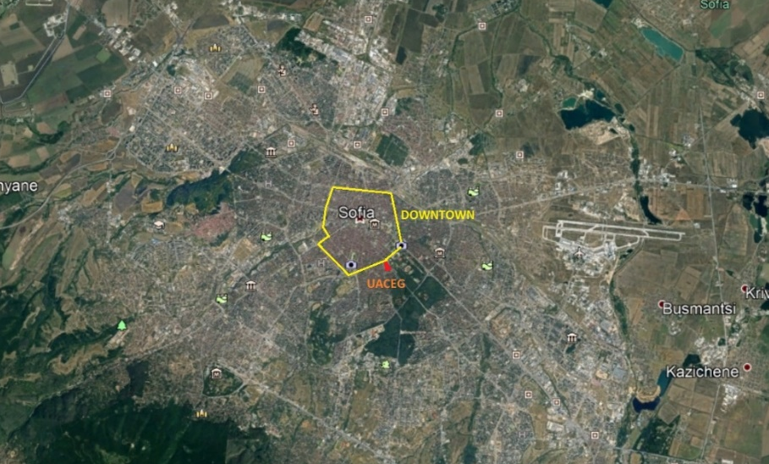
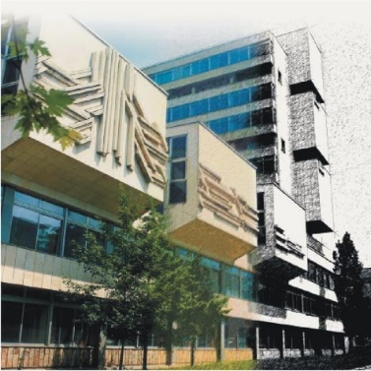
Location
Europe, Bulgaria,
Sofia, 1 Hr. Smirnenski Blvd
www.uacg.bg
Strengthening of master curricula in water resources management
for the Western Balkans HEIs and stakeholders

Slide 4
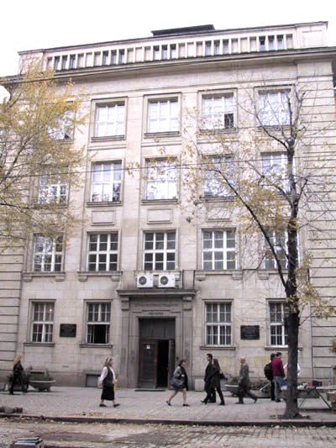
History
Established in 1942 as a Higher Technical School
  1945 – transformed into a State Polytechnic.
  1953 - separated as Higher Institute for Architecture and Civil Engineering
  1995 - transformed into University of Architecture, Civil Engineering and Geodesy (UACEG) on July 21, 1995 by decision of the National Assembly.
All architects, civil engineers and geodesists in Bulgaria between 1945 and 1995 were educated in UACEG.
Strengthening of master curricula in water resources management
for the Western Balkans HEIs and stakeholders

Slide 5
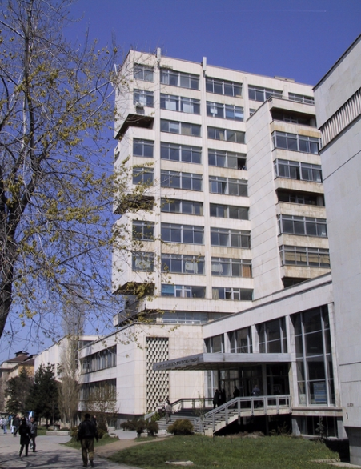
UACEG Now
There are 5 faculties at UACEG
  Faculty of Architecture
  Faculty of Structural Engineering
  Faculty of Hydraulic Engineering
  Faculty of Transportation Engineering
  Faculty of Geodesy
The Academic Staff of UACEG:
  44 Full Professors
  105 Associate Professors
  169 Assistant Professors
    77 of them have PhD degree
Around 3500 students
Strengthening of master curricula in water resources management
for the Western Balkans HEIs and stakeholders

Slide 6
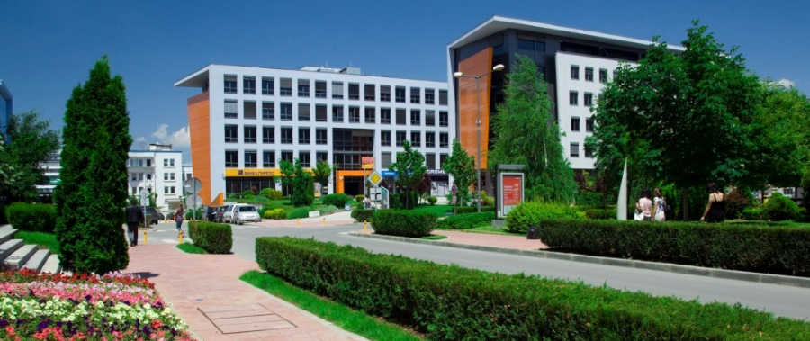
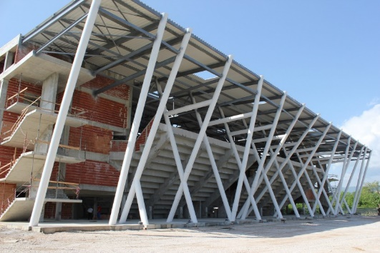
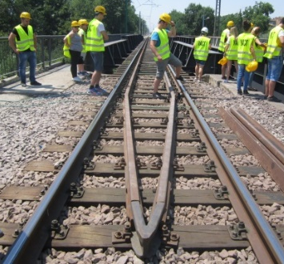
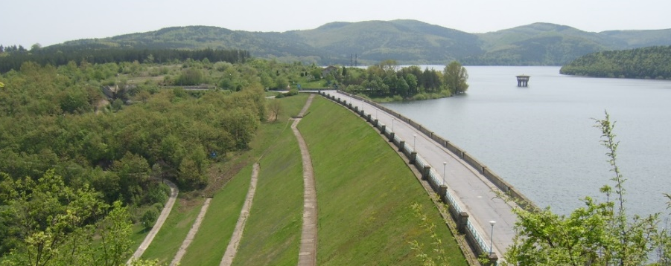
Study Programs
Master Degree Programs (MA)
  Architecture
  Landscape Architecture
  Structural Engineering
  Water Supply and Sewerage
  Hydraulic Engineering
  Transportation Engineering
  Geodesy
  Structural Engineering in English
NB: These are “direct” Master Degree programs with duration of 5 or 5 ½ years, without intermediate Bachelor Degree.
Strengthening of master curricula in water resources management
for the Western Balkans HEIs and stakeholders

Slide 7
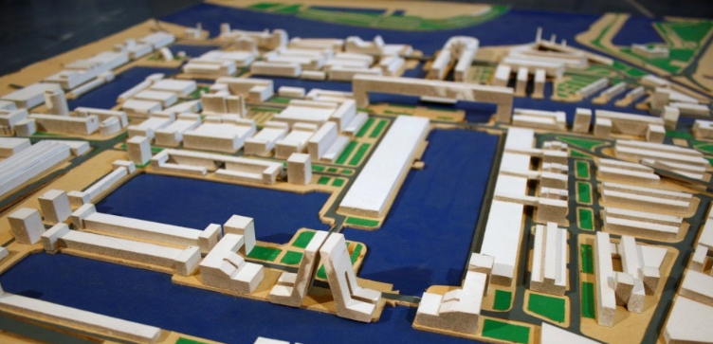
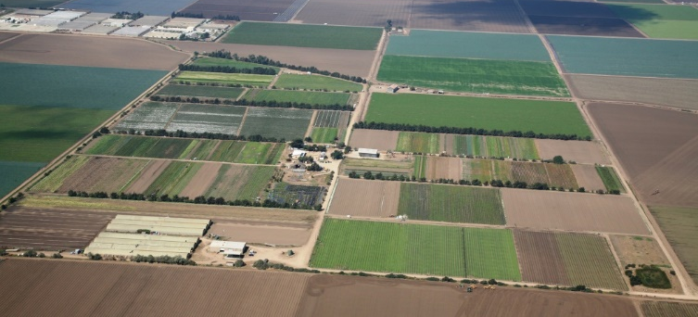
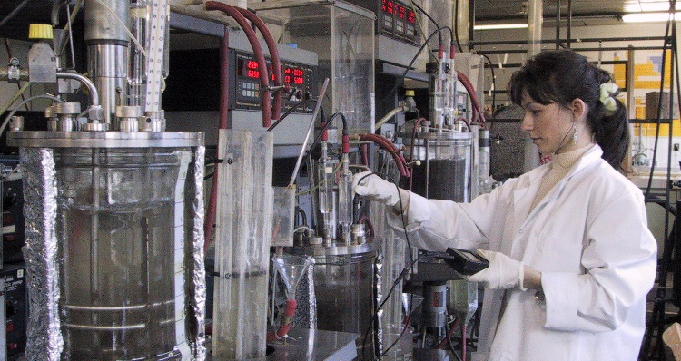
Study Programs
Bachelor Degree Programs (BA)
  Urban Planning
  Construction Management
  Land and Real Estate Management and Planning
  Engineering Ecology
NB: All Bachelor Degree programs in Bulgaria have duration of 4 years (8 semesters)
MA programs for all BA degree programs are offered
  Short MA degree programs have duration of 1 ½ or 2 years
Strengthening of master curricula in water resources management
for the Western Balkans HEIs and stakeholders

Slide 8
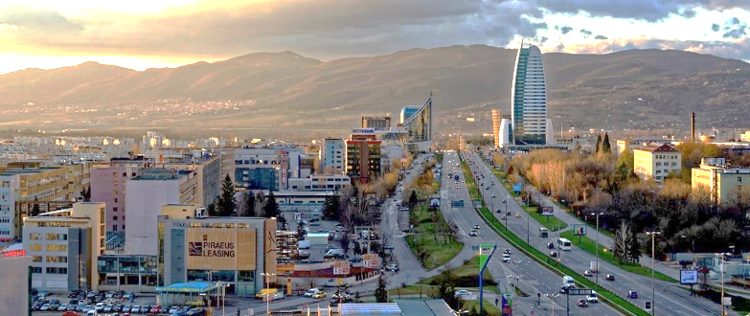
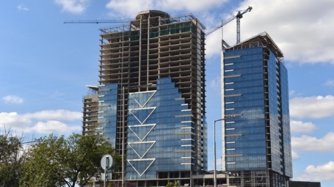
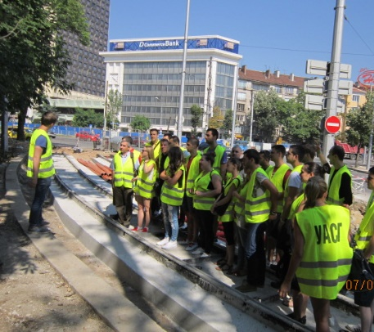
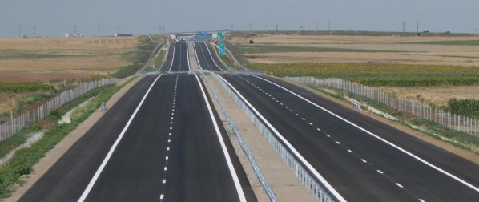
Study Programs
Short Master Degree Programs (SMA)
  Urban Planning
  Structural Engineering
  Reconstruction and Modernization of Buildings and Facilities
  Analysis and Design of Structures
  Project Management in Construction
  Transportation Engineering
  Geotechnical Engineering
  Infrastructure Construction – Transportation Engineering (in German)
Strengthening of master curricula in water resources management
for the Western Balkans HEIs and stakeholders

Slide 9
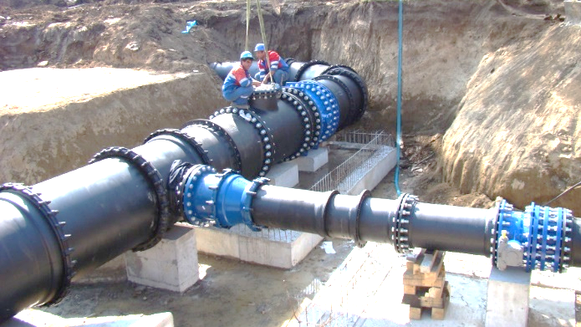
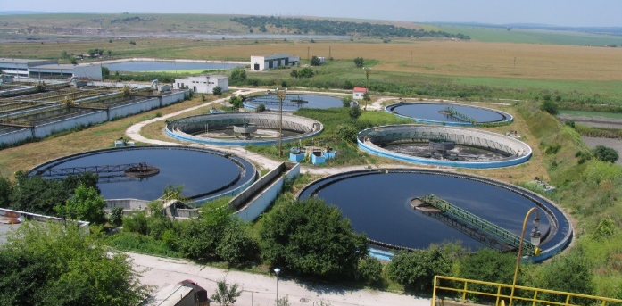
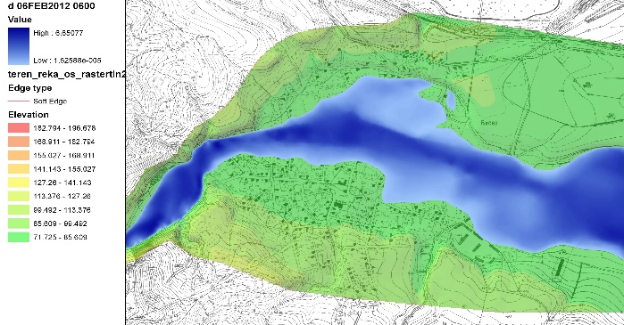
Study Programs
Short Master Degree Programs (SMA)
  Management of EU Infrastructure projects
  Cadastre
  Photogrammetry and Spatial Information Systems
  In Faculty of Hydraulic Engineering
  Water Supply and Sewerage Systems and Facilities
  Water and Wastewater Treatment
  Hydraulic Engineering
  Irrigation and Drainage Engineering
  Water Маnagement
  Gas Supply
  Engineering Ecology
Strengthening of master curricula in water resources management
for the Western Balkans HEIs and stakeholders

Slide 10
Project Participation
International Research Projects
  ABOT – “Assessment of water Balances and Optimization based Target setting across EU River Basins”, Grant Agreement Nr.07.032900/2011/612888/SUB/D1, DG Environment – Halting Desertification in Europe 2011
  2011-2014 EU Commission DG Research FP7 - "Meso-level eco-efficiency indicators to assess technologies and their uptake in water use sectors“
  2013-2015 Swiss-BG cooperation - Innovative P-recovery from waste sludge (INNOVA P-recovery) Nr. IZEBZO_143004/1
  2011-2014 Strategic & Technological Advancement in Research on AgroEnergy
Strengthening of master curricula in water resources management
for the Western Balkans HEIs and stakeholders

Slide 11









Project Participation
Improving flood prevention and flood hazard awareness through the development of a standardized approach
for small dams risk assessment and management
based on European best practices and shared experience (2011 – 2013)
Beneficiaries:
CO: Civil Protection Directorate-General, Bulgaria
AB1: WALD + CORBE Consulting Engineers, Baden-Württemberg, Germany
AB2: Institute of Hydraulic Engineering and Water Resources Management, TU Vienna, Austria
AB3: Department of Flood Water Management, Federal Government of Styria, Austria
AB4: Irrigation Systems (Ministry of Agriculture and Foods), Bulgaria
AB5: National Institute for Meteorology and Hydrology (Bulgarian Academy of Sciences), Bulgaria
AB6: University of Architecture, Civil Engineering and Geodesy in Sofia, Bulgaria
AB7: Sofia University “St. Kliment Ohridski”, Faculty of Geology and Geography, Bulgaria
Strengthening of master curricula in water resources management
for the Western Balkans HEIs and stakeholders
www.swarm.ni.ac.rs

Slide 12






Project Participation
TRIBUTE – TRigger BUffer zones for inundaTion Events (2017 – 2018)
The aim is to help Europe-wide national, regional and local CP authorities answer the following vital question in case of flooding:
“Should I initiate an evacuation and how long do I have to evacuate safely?”
Beneficiaries:
CO: National Technical University of Athens, Greece
BE1: National Observatory Of Athens, Greece
BE2: ARATOS-SYSTEMS, The Netherlands
BE3: Information Technology for Humanitarian Assistance, Cooperation and Action – ITHACA, Italy
BE4: ANYSOLUTION, Spain
BE5: Universitat de les Illes Balears, Spain
BE6: University of Architecture, Civil Engineering and Geodesy in Sofia, Bulgaria
Strengthening of master curricula in water resources management
for the Western Balkans HEIs and stakeholders
www.swarm.ni.ac.rs

Slide 13
Project Participation
The World Bank Projects (in Bulgaria)
  “Draft Common Strategy for Management and Development of Hydro-melioration and Protection Against Harmful Effects of Water” (2014-2015)
  “Development of a financing strategy, regulatory capacity building and increase of service efficiency in the WSS sector (2016-2017)
  “Technical Assistance: Municipal Infrastructure Development Plans”. Managing Municipal Dams in Bulgaria - Risk Assessment and Development (2017).
  “Avoidance of Excessive Costs through the Definition of Agglomerations and Guidance on Individual and other Appropriate Solutions for Wastewater Treatment” (2014-2015)
  “International Practices for the Development and Implementation of Cost Recovery Water Pricing in the WSS sector” (2015)
Strengthening of master curricula in water resources management
for the Western Balkans HEIs and stakeholders

Slide 14
Project Participation
Climate Change Projects
  “Assessment of the Pressures and Impacts on Surface Waters and Groundwaters from Climate Changes and Assessment of the Availability of Water for the Economic Sectors”, Ministry of Environment and Water of Bulgaria (2014-2016);
  “Strengthening Strategic Planning on Climate Change Adaptation, including providing inputs for the preparation of a National Climate Change Adaptation Strategy, together with an Action Plan”, The World Bank, for the Ministry of Environment and Water of Bulgaria (2017 – now)
Strengthening of master curricula in water resources management
for the Western Balkans HEIs and stakeholders

Slide 15
Project Participation
Other Projects
  Project BG05M2OP001-1.002-0019: „Clean technologies for sustainable environment – waters, waste, energy for circular economy“ (on going);
  “Development of Flood risk management plans for Danube river basin”, Danube River Basin Directorate, Bulgaria (2015)
  “Elaboration of Flood Hazard and Risk Maps for East Aegean River Basin Directorate”. East Aegean River Basin Directorate, Bulgaria (2015)
  “Project for catalog of measures for Black Sea River Basin Directorate” Black Sea River Basin Directorate, Bulgaria (2016).
  “Elaboration of flood hazard maps and flood risk maps for West Aegean River Basin Directorate”, West River Basin Directorate, Bulgaria (2015)
  “Flood Warning System Establishment in Arda River Basin For Minimizing the Risk in the Cross Border Area” (ARDAFORECAST), European Regional Development Fund (2013-2014)
Strengthening of master curricula in water resources management
for the Western Balkans HEIs and stakeholders

Slide 16
THANK YOU FOR YOUR ATTENTION!
Strengthening of master curricula in water resources management
for the Western Balkans HEIs and stakeholders

